Slide 1
Student Management System
By Zainab Bai E
Enrollment No:EBEON1021459495

Slide 2
Slide Title
Abstract
Output Screen
Details added Screen
Buttons Details
Generate Receipt Button
Print button
Fee Receipt

Slide 3
Abstract
GUI application which provides the details of the college student, about his course and the fees that need to be paid. The fee is calculated and saved in a text file. The program must also be able to print the receipt.

Slide 4
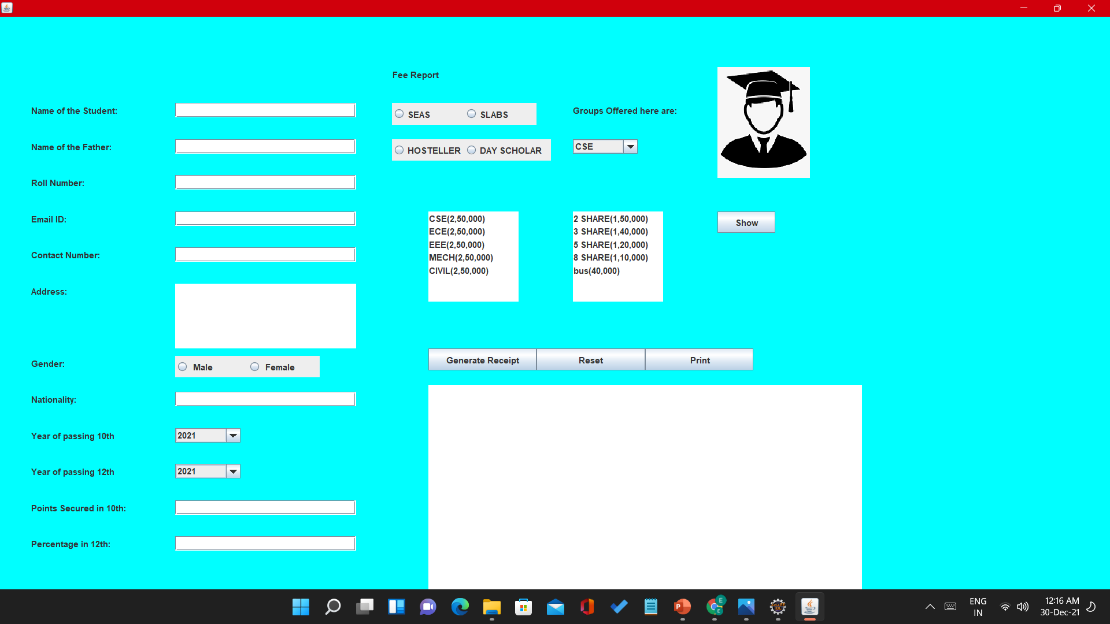
Output Screen

Slide 5
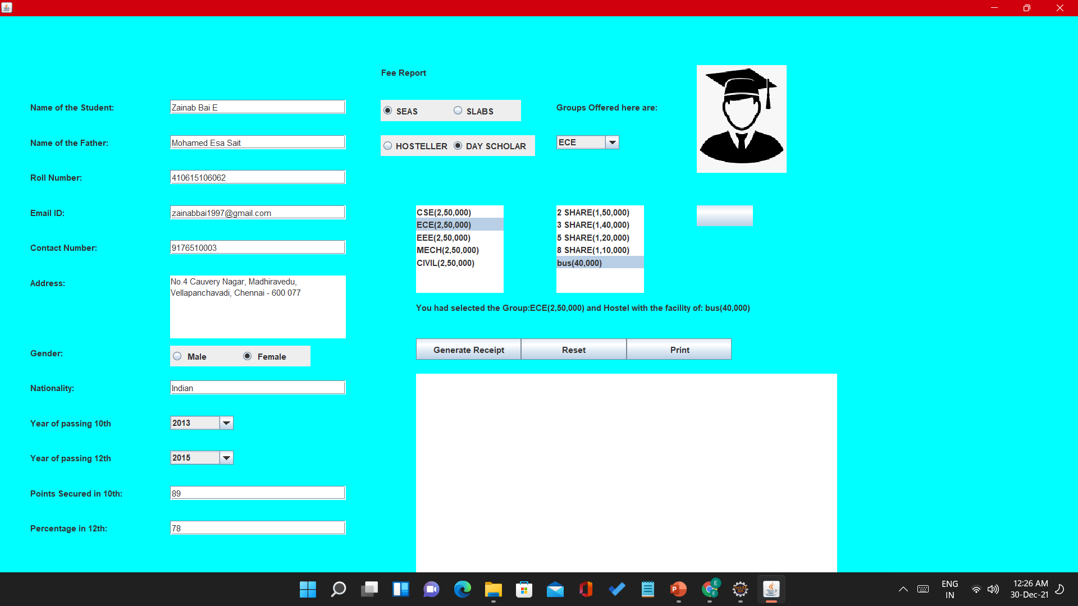
Details Added Screen

Slide 6
Button Details
Receipt: The prime functionality of this method is to display all the data that is entered in the text fields, the course to be taken and the final amount that needs to be paid. These operations can be done by adding ActionListener to the button named as receipt.
Reset: The functionality of this method is to clear the information that is already visible to in the text areas and in the text fields and to add new student’s details and print the fees of that particular student. It can be done by adding ActionListener to the button.
Print: The functionality of this method is to print the fee receipt if the printer is available. We can do this by adding ActionListener to the button. The entire information in the text area is named as area2 and is saved in a file in the computer under the name of java.txt. It will also show a dialog box as Data saved successfully.

Slide 7
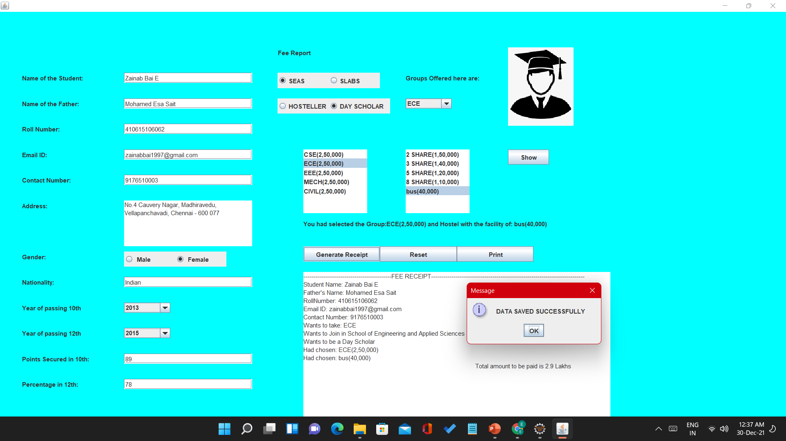
Generate receipt button

Slide 8
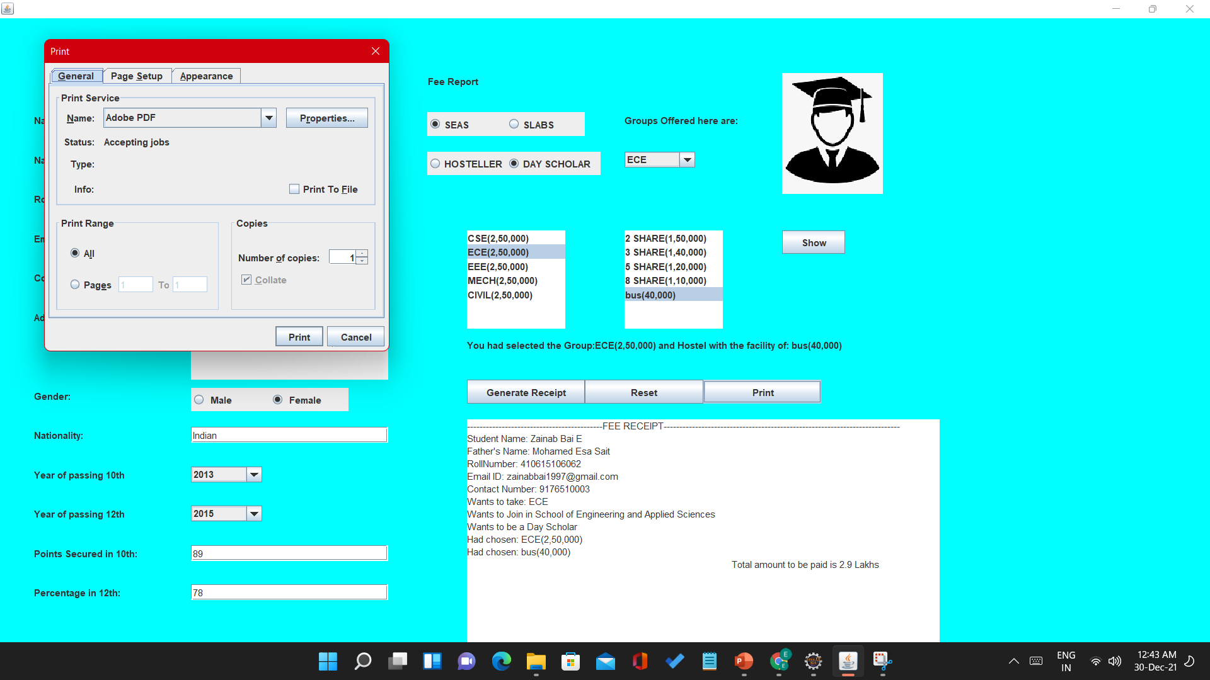
Print Button

Slide 9
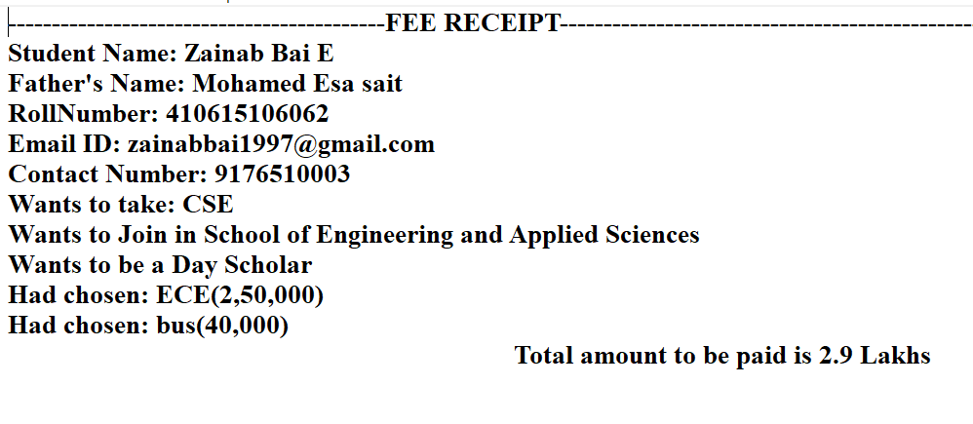
Fee Receipt

Slide 10
Thank You

